Slide 1
Global Cross-Border E-Commerce Training
Unit 5 Cross-Border E-Commerce Big Data Analysis
Lecturer: Tim
Global Cross-Border E-Commerce Training | Unit 5 Cross-Border E-Commerce Big Data Analysis
Global Cross-Border E-Commerce Training | Unit 5 Cross-Border E-Commerce Big Data Analysis

Slide 2
卖家身份 Seller
15年进⼊亚⻢逊，
Became an Amazon seller in 2015
产品销量位居热⻔品类top3，
Products sales ranked top3 in popular categories.
年销售量30万单，年销售额2亿⼈⺠币+，
Annual sales of 300,000 deals for 200 million+ RMB
上线产品30%以上转化率，90%存活率。
Over 30% conversion rate and 90% survival rate of listed products
罗挺Tim
Global Cross-Border E-Commerce Training | Unit 5 Cross-Border E-Commerce Big Data Analysis

Slide 3
亚⻢逊⼤数据分析⼯具Sorftime 创始⼈
Founder of Sorftime, Amazon’s Big Data Analysis Tool
解决卖家三⼤场景痛点，卖家⽤户覆盖超过45个国家，⽤户总量近30万，⽇活10万+
Solved the pain points of the three scenarios for sellers, covering more than 45 countries, with a total of nearly 300,000 users and over 100,000 daily users
亚⻢逊SPN官⽅认证服务机构
Amazon’s SPN official certification service organization
国内亚⻢逊前⼗培训机构特聘讲师
Distinguished lecturer of Top 10 Amazon training institutions in China
2018年 中国服务贸易协会“⼀带⼀路” 跨境电商⾼级研修班讲师
Lecturer of CATIS “Belt and Road” Cross-Border E-Commerce Senior Seminar in 2018
罗挺Tim
Global Cross-Border E-Commerce Training | Unit 5 Cross-Border E-Commerce Big Data Analysis

Slide 4
亚⻢逊⼤数据分析⼯具Sorftime 创始⼈
Founder of Sorftime, Amazon’s Big Data Analysis Tool
全国跨境电商⾏业引领优秀品牌企业；全国跨境电商软件⾏业十⼤著名优秀企业
Leading excellent brand enterprise in the national cross-border e-commerce industry;
Top 10 famous enterprises in the software industry of cross-border e-commerce in China
原创《选品⾰命》课程，18-21年在全国授课超过200场，影响超过40万亚⻢逊卖家，认可度100%
Original course Selection Revolution was taught in more than 200 sessions in China from 2018 to 2021, affecting more than 400,000 Amazon sellers and winning 100% recognition.
各培训机构专⽤教学软件
Specialized teaching software for training institutions
2020-2021 中国科学家论坛 科技创新先进单位；科技创新发明成果奖
Advanced Unit of Science and Technology Innovation on 2020-2021 China Scientists Forum;
Scientific and Technological Achievement Awards
罗挺Tim
Global Cross-Border E-Commerce Training | Unit 5 Cross-Border E-Commerce Big Data Analysis

Slide 5
重庆亚马逊卖家孵化培训中心 创办人
Founder of Chongqing Amazon Seller Incubation and Training Center
2019-2022成功孵化50家亚⻢逊公司，⽇均出单50+
Successfully incubated 50 Amazon companies from 2019 to 2022, taking more than 50 orders per Day
重庆7所重点⾼校产学研实践基地，重庆外语外事学院双创导师
Industry-Academia-Research practice base of 7 key universities in Chongqing,
entrepreneurship and innovation tutor at Chongqing Institute of Foreign Studies
2021年培训200名应届毕业⽣，且全部就业
Trained 200 graduates in 2021, with all employed finally
亚⻢逊在⻄南唯⼀的SPN认证机构机构，重庆唯⼀的合作伙伴
Amazon's only SPN certification body in southwest China and its sole partner in Chongqing
罗挺Tim
Global Cross-Border E-Commerce Training | Unit 5 Cross-Border E-Commerce Big Data Analysis

Slide 6
重庆亚马逊卖家孵化培训中心 创办人
Founder of Chongqing Amazon Seller Incubation and Training Center
重庆亚马逊卖家孵化培训中心 创办人
Founder of Chongqing Amazon Seller Incubation and Training Center
重庆市商委跨境电商亚⻢逊推⼴指定宣传培训单位
Designated publicity and training unit for Amazon promotion of cross-border e-commerce by Chongqing Municipality Commerce Commission
重庆两江跨境电商产业园运营单位
Operating Unit of Chongqing Liangjiang Cross-Border E-Commerce Industrial Park
重庆跨境电商协会发起单位
The initiator of Chongqing Cross-Border E-Commerce Association
政府挂职：重庆北碚区经信委副主任
Government post: deputy director of Economic and Information Commission of Beibei District, Chongqing
罗挺Tim
Global Cross-Border E-Commerce Training | Unit 5 Cross-Border E-Commerce Big Data Analysis

Slide 7
目录
01.
跨境电商数据分析的必要性（竞争变化背景）
The Necessity of Cross-Border E-Commerce Data Analysis
(Background of Competition Change)
CONTENTS
02.
跨境电商数据分析的主要项目及意义
Main Projects and Significance of Cross-Border E-Commerce Data Analysis
03.
亚⻢逊平台的运营底层逻辑
The Underlying Operational Logic of Amazon
04.
数据化选品的完整闭环方法论
A Complete Closed-loop Methodology for Data-based Product Selection
05.
实操演示
Demonstration of Practical Operation
Global Cross-Border E-Commerce Training | Unit 5 Cross-Border E-Commerce Big Data Analysis

Slide 8
跨境电商平台数据分析培训背景 Background of Cross-Border E-Commerce Data Analysis Training
01
当前跨境电商市场数据调研分析和数据化选品的必要性
the necessity of market data research&analysis and data-based product selection for cross-border e-commerce at present
Global Cross-Border E-Commerce Training | Unit 5 Cross-Border E-Commerce Big Data Analysis

Slide 9
全球跨境电商运营首选平台代表-亚马逊 背景原因分析
Amazon, the Representative Preferred Platform for Global Cross-Border E-Commerce Operation,
Background Cause Analysis
向好Good situation：
产品在平台的权重更高 -获得平台更多推荐-有更多机会被消费者看到，产⽣更多点击，更多点击有更大机会被转化
Products would be given more weight by the platform - win more recommendations on the platform - have more chances to be seen by consumers - generate more clicks, and thus more clicks are more likely to convert.
电商运营的基本逻辑：
Basic logic of e-commerce operation:
流量曝光-点击-转化
Flow Exposure - Click - Conversion
(传统：搜索电商；流⾏：兴趣电商)
(Traditional: search-based e-commerce;
Current: interest-based e-commerce)
向差Bad situation：
相反，权重逐渐下降，流量更小，机会更小
On the contrary, the weight gradually decreases; the flow shrinks; the opportunity becomes smaller.
Global Cross-Border E-Commerce Training | Unit 5 Cross-Border E-Commerce Big Data Analysis

Slide 10
全球跨境电商运营首选平台代表-亚马逊 背景原因分析
Amazon, the Representative Preferred Platform for Global Cross-Border E-Commerce Operation,
Background Cause Analysis
亚马逊平台发展分水岭
The Watershed of Amazon’s Development
2016-未来
After 2016
流量大于供给
Flow > Supply
流量小于供给
Flow < Supply
竞争宽松
Loose Competition
只要在⾼需求的市场上架产品，都能获得平台的流量曝光，利润高，毛利相对稳定。
As long as the listed products are in a high-demand market, they can obtain the platform's flow exposure, high profits, and relatively stable gross profits.
原始的选品方式相对粗暴和单⼀，以需求(市场规模)和爆款为导向。
The original method of selecting products was relatively rough and simple, with demand(market size) and popular style oriented.
2016年前
Before 2016
供需失衡
An imbalance between supply and demand
狼多肉少，竞争日趋激烈，普遍门槛较低-产品同质化严重，开始出现杀价和花钱抢流量的现象，利润空间压缩，无法覆盖流量成本，产品转化率和推⼴费成为影响毛利率和成败的关键变量。
Competition is increasingly fierce, and the general threshold becomes lower. Product homogenization is severe. The phenomenon of bargaining and buying flow began to appear. Profit space is compressed, failing to cover the cost of flow. Product conversion rate and promotion costs become key variables affecting gross margin and success.
依赖规模效应-投资回报周期过⻓，投资回报率极低。
Dependence on scale effect - investment return cycle is too long, and the investment return rate is too low.
Global Cross-Border E-Commerce Training | Unit 5 Cross-Border E-Commerce Big Data Analysis

Slide 11
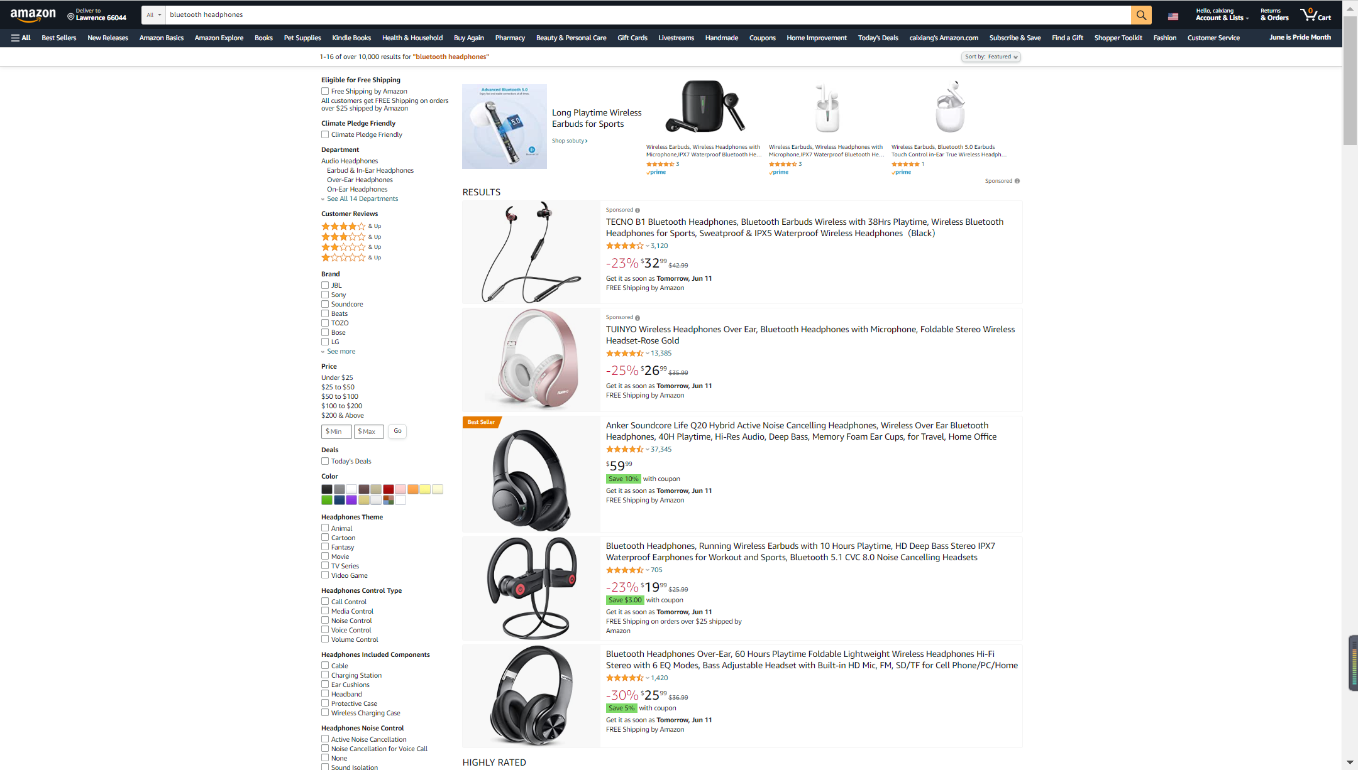
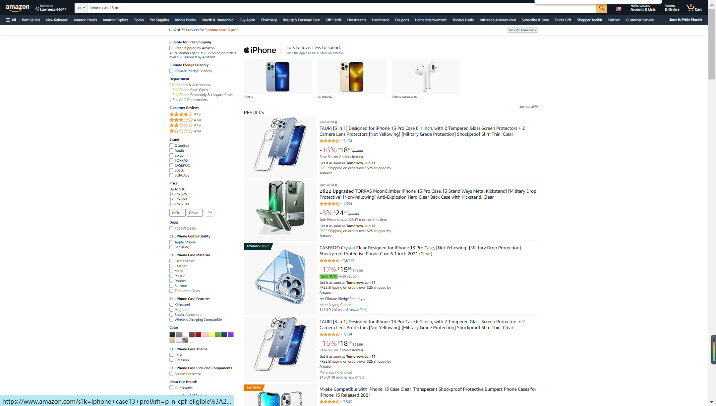
案例：平台⻚⾯(前台关键词搜索⻚⾯)
Case: platform page (keywords search page from the front desk)
BlueTooth headphones/iPhone case13 pro
Global Cross-Border E-Commerce Training | Unit 5 Cross-Border E-Commerce Big Data Analysis

Slide 12
”
当前跨境电商平台低风险，
高效率运营必须依靠全面科学的数据调研分析作为支撑
The current low-risk and high-efficiency operation of cross-border e-commerce platforms must rely on comprehensive and scientific data research and analysis as support
Global Cross-Border E-Commerce Training | Unit 5 Cross-Border E-Commerce Big Data Analysis

Slide 13
跨境电商数据分析的主要项目及意义
02
Main Projects and Significance of
Cross-Border E-Commerce Data Analysis
Global Cross-Border E-Commerce Training | Unit 5 Cross-Border E-Commerce Big Data Analysis

Slide 14
选品
product selection
选品类(市场的选择)
Categories Selection(choosing market)
产品打造（进入目标市场的单品选择）
Product Building
(selecting items to enter the target market )
清晰定位：⾃身条件/资⾦/团队/账号/物流/供应商/站外资源/专利⻛险
Clear positioning: own conditions/ capital/ team/ account/ logistics/ suppliers/ off-site resources/patent risk
选择适合的运营品类，降低⻛险，⾼效回报
Choose the appropriate category to operate, reduce risk, and make return efficient
站内：现有产品/延伸周边产品
Within the site: existing products/ extension of peripheral products
站外：新需求/潜在热点
Outside the site: new demand/potential hot topics
卖点梳理，差异化打造，确保利润的前提下，保持高转化率
Sort out selling points, shape differentiation, and maintain a high conversion rate on the premise of profits
产品体系，结构搭建，定价定位，不同使命
Products systematization, structure building, pricing positioning, mission differentiation
迭代优化升级
Iterative optimization and upgrade
Global Cross-Border E-Commerce Training | Unit 5 Cross-Border E-Commerce Big Data Analysis

Slide 15
运营
Operation
推广投入产出：站内站外
Input and output of the promotion: inside and outside the site
物流：方式，周转
Logistics: mode, turnover
财务
Finance
售后
After-sales
Global Cross-Border E-Commerce Training | Unit 5 Cross-Border E-Commerce Big Data Analysis

Slide 16
亚⻢逊平台的运营底层逻辑
03
The Underlying Operational Logic of Amazon
Global Cross-Border E-Commerce Training | Unit 5 Cross-Border E-Commerce Big Data Analysis

Slide 17
卖家需求VS平台需求
Seller Demand vs Platform Demand
卖家需求：不是销量，⽽是利润。
Seller demand: not sales volume, but profit.
更⾼的亚⻢逊权重(获得平台A9算法的认可) ——更多的⾃然(免费)流量曝光——有利润/更⾼的利润
Higher weights from Amazon (getting approval from the platform’s A9 algorithm) —— more natural (free) flow exposure —— positive profit/higher profit
平台需求：客户体验度
Platform demand: customer experience
获得平台认可：⽐同类产品具有更⾼的点击率——更⾼的转化率 —— 同类产品更⾼更稳定的价格——更⾼的销量——更多更好的评价数量
Platform’s recognition: higher click-through rate compared with similar products—— higher conversion rate —— higher and more stable price —— higher sales —— more favorable comments from buyers
Global Cross-Border E-Commerce Training | Unit 5 Cross-Border E-Commerce Big Data Analysis

Slide 18
亚⻢逊店铺成功经营的核⼼要素
The Core Element of a Successful Amazon Store
转化率
Conversion Rate
在同⼀品类⾥⽐竞品更好的满⾜消费者的各种需求(产品和⼼理)，
⽐同类更加优秀。
Among specific categories, if one product can better meet the various needs of consumers than its competitors(physically and psychologically), it will stand out.
Global Cross-Border E-Commerce Training | Unit 5 Cross-Border E-Commerce Big Data Analysis

Slide 19
选品的终极目标
The Ultimate Goal of product selection
7分选品，3分运营
Seven points by product selection, three points by operation.
能够在有利润的前提下 ，尽快、安全、持续、稳定上升地⾃然出单
Increase the number of orders naturally in an efficient, safe, and sustainable way under the premise of profits.
Global Cross-Border E-Commerce Training | Unit 5 Cross-Border E-Commerce Big Data Analysis

Slide 20
要成功经营跨境电商，达到以极低的风险和较高的效率赚取利润的目的，首先要让产品获得平台的认可，学会科学的数据分析选品方法是第⼀步，也是最重要的⼀环。
To operate successfully in cross-border e-commerce, and earn profits with very low risk and high efficiency, the first stage is to make products recognized by the platform. Learning scientific methods of product selection based on data analysis is the first and most essential step.
”
Global Cross-Border E-Commerce Training | Unit 5 Cross-Border E-Commerce Big Data Analysis

Slide 21
数据化选品的完整闭环方法论
04
A Complete Closed-loop Methodology
for Data-based Product Selection
Global Cross-Border E-Commerce Training | Unit 5 Cross-Border E-Commerce Big Data Analysis

Slide 22
细分品类的选择
Subdivided Category Selection
为什么不能选择行业，而是要选择细分品类？
Why choose a subdivided category rather than an industry?
Global Cross-Border E-Commerce Training | Unit 5 Cross-Border E-Commerce Big Data Analysis

Slide 23
细分品类的选择
Subdivided Category Selection
市场总销量（需求大小）
Total market sales (demand size)
产品销量集中度（单品销量垄断性，产品销量分布，TOP100最后一名销量）
The concentration of product sales (monopolization of single product sales, distribution of product sales, the sales of No.100)
新品比例
The proportion of new products
FBA&FBM比例
The proportion of FBA&FBM
品牌集中度
Brand concentration
评分星级（头部产品星级评分与销量占比的关系；售后风险）
Star rating (the relationship between the star rating of the head products and the proportion of their sales; After-sales risk)
细分品类的数据分析
需要总结的维度
Dimensions to be summarized for data analysis of subdivided categories
Global Cross-Border E-Commerce Training | Unit 5 Cross-Border E-Commerce Big Data Analysis

Slide 24
细分品类的选择
Subdivided Category Selection
A+视频比例
The proportion of A+ videos
店铺集中度（单店铺对销量的垄断性）
Store concentration (monopolization of sales by a single store)
变体比例
The proportion of variations
重量&体积：物流方式&资金需求&资金运用效率
Weight & volume: logistics mode & funds demand & efficiency in the use of funds
卖家属性（第三方&亚马逊自营）
Seller attributes (third-party & sold by Amazon)
品牌旗舰店比例
The proportion of brand flagship stores
细分品类的数据分析
需要总结的维度
Dimensions to be summarized for data analysis of subdivided categories
Global Cross-Border E-Commerce Training | Unit 5 Cross-Border E-Commerce Big Data Analysis

Slide 25
细分品类的选择
Subdivided Category Selection
评价数量（头部产品评价数量与销量占比的关系；最低评价数量产品的销量）
Amount of feedback (the relationship between the feedback amount of the head products and the proportion of their sales; the sales volume of products with the lowest amount of feedback)
销量增长趋势
Sales growth trend
榜单变化率
Change rate of the list
新老产品上架时间分布比例
New and old products’ launch time distribution ratio
中国卖家与海外卖家比例
The ratio of Chinese sellers to overseas sellers
细分品类的数据分析
需要总结的维度
Dimensions to be summarized for data analysis of subdivided categories
Global Cross-Border E-Commerce Training | Unit 5 Cross-Border E-Commerce Big Data Analysis

Slide 26
细分品类的选择
Subdivided Category Selection
总卖家数量和总产品数量
Total number of sellers and total number of products
跟卖数量
Sales volume via Amazon’s service of “sell yours”
无品牌占比
The proportion of unbranded products
平均客单价
The average order price
CPC最高价格
The CPC maximum price
市场变化趋势
Market trend
细分品类的数据分析
需要总结的维度
Dimensions to be summarized for data analysis of subdivided categories
Global Cross-Border E-Commerce Training | Unit 5 Cross-Border E-Commerce Big Data Analysis

Slide 27
细分品类的选择
Subdivided Category Selection
经过推广期仍然表现稳定的新品
New products with stable performance after the promotion period
排名走势/评价增长真实/价格无变动/无过度促销/站外无deals
Ranking trend/real growth of feedback/no price change/no excessive promotion/no off-site deals
>
寻找产品参考蓝本
Look for the product reference sample
测算
Measurement
产品成本/合理运输方式的运费/站内广告成本/FBA费用/盈亏平衡点/最大亏损预期/最坏情况下的ROI
Product cost/freight for the reasonable way of transportation/in-site advertising cost /FBA fee/the breakeven point/maximum loss expectation/ROI in the worst-case scenario
>
Global Cross-Border E-Commerce Training | Unit 5 Cross-Border E-Commerce Big Data Analysis

Slide 28
产品的打造
Product Building
优点共性（刚性卖点）
Common advantages (rigid selling points)
缺点共性（差异化卖点）
Common weaknesses（differentiation selling point）
疑问（新需求）
Questions (new demand)
买点总结（产品开发需求）
Summary of buying points (product development requirements)
准listing模板：关键词梳理/图片逻辑/视频脚本/QA和评论设计
Quasi-listing template: keywords combing/image logic/video scripting /QA and comment design
品牌故事包装
Brand story packaging
运营方案：产品备货资金需求/物流资金需求/站内外推广方案资金需求
Operation plan: fund demand for product stock preparation/logistics fund demand/fund demand for promotion plan inside and outside the site
Global Cross-Border E-Commerce Training | Unit 5 Cross-Border E-Commerce Big Data Analysis

Slide 29
供应链开发方法
Supply Chain Development Methodology
配合度：
专业分析/规划/起订量/生产交期/品质把控/知识产权风险/新品优先推荐/优化配合/成本/账期
Cooperation degree:
professional analysis/ planning/ Minimum Order Quantity/
production and delivery date/ quality control/ intellectual property risk/
new product priority recommendation/
optimization and coordination/ cost/ account period
寻找供应商
Look for suppliers
Global Cross-Border E-Commerce Training | Unit 5 Cross-Border E-Commerce Big Data Analysis

Slide 30
综合SWOT
Comprehensive SWOT
市场评价标准 VS 产品评价标准
Market Evaluation Criteria VS Product Evaluation Criteria
Global Cross-Border E-Commerce Training | Unit 5 Cross-Border E-Commerce Big Data Analysis

Slide 31
没有产品垄断销量，霸占流量⼊⼝
No product monopolizes sales to hog flow entry
没有品牌占领此品类的消费者⼼智，霸占流量⼊⼝
No brand monopolizes consumers’ minds on the category to hog flow entry
没有店铺霸占品类主要流量⼊⼝
No store occupies the main flow entrance of the category
亚⻢逊⾃营在品类⾥没有优势
“Sold by Amazon” has no advantage in categories.
评价数量要求低
Low requirements for the number of comments
售后⻛险低或者可改进空间⾼
Low after-sales risk or high room for improvement
新品占⽐及销量份额⾼，新品冲击⼒强、机会⼤
The proportion and sales of new products are high. The impact of new products is strong.
The opportunity is big.
可采取的物流⽅式，头程成本低，资⾦运⽤⾼
Adoptable logistics modes, low FBA cost, high capital utilization rate
⾃发货⽐例及份额⼤
Large proportion and share of independent shipment
综合SWOT
Comprehensive SWOT
市场评价标准
Market Evaluation Criteria
Global Cross-Border E-Commerce Training | Unit 5 Cross-Border E-Commerce Big Data Analysis

Slide 32
综合SWOT
Comprehensive SWOT
产品元素丰富，溢价能⼒强，可包装点多，客户挑选意愿强，产品属性⼴阔
Rich product elements, strong premium capability, many packaging points, strong customer choice, and broad product attributes
价格天花板较⾼且稳定，产品成本低
The price ceiling is high and stable, while the cost is low.
品类综合转化率较⾼
The comprehensive conversion rate of the category is high.
⽩帽推⼴成本低，⽑利能够完全覆盖
The cost of “white-hat promotion” is low, and the gross profit can fully cover it.
竞争对⼿综合实⼒及条件较弱
The overall strength and conditions of competitors are weak.
品类有稳定的需求
The category has stable demand.
需求持续稳定，或增加迅速，其他维度趋势均向好
Demand is stable or increasing rapidly. Trends of other dimensions are all positive.
Top100坑位未满
There are still vacancies in the Top 100 list.
市场评价标准
Market Evaluation Criteria
Global Cross-Border E-Commerce Training | Unit 5 Cross-Border E-Commerce Big Data Analysis

Slide 33
综合SWOT
Comprehensive SWOT
在有较⼤需求的品类.
The product belongs to a category with greater demand.
对标产品上架时间短，评价数量少
The shelf time of the bench-marking products is short, and the amount of feedback is small.
对标产品有不错的销量
The bench-marking products have good sales.
对标产品排名上升较快
The ranking of the bench-marking products rose quickly.
对标产品相关关键词排名靠前
Keywords related to the bench-marking products rank at the top.
对标的同类代表性产品排名趋势向好
The ranking of representative bench-marking products in the same category is improving.
差异化的产品外观、功能、性能
Differentiated product appearance, function, and performance
产品评价标准
Product Evaluation Criteria
Global Cross-Border E-Commerce Training | Unit 5 Cross-Border E-Commerce Big Data Analysis

Slide 34
综合SWOT
Comprehensive SWOT
站内关键词趋势向好
The trend of keywords inside the site is good.
⾕歌关键词趋势向好
The trend of Google keywords is positive.
安全合规，⽆侵权⻛险
Safety compliance, no infringement risk
较⾼的零售价格，较低的产品成本
High retail prices, low product costs
可采取的物流⽅式，头程成本
Adoptable logistics mode, FBA cost
不断有新的功能需求
New functional requirements keep emerging.
友好的竞争环境
A friendly competitive environment
产品评价标准
Product Evaluation Criteria
Global Cross-Border E-Commerce Training | Unit 5 Cross-Border E-Commerce Big Data Analysis

Slide 35
实操演示
05
Demonstration of Practical Operation
Global Cross-Border E-Commerce Training | Unit 5 Cross-Border E-Commerce Big Data Analysis

Slide 36
Plug-ins on web pages
Softwares
Wechat mini-programs
Global Cross-Border E-Commerce Training | Unit 5 Cross-Border E-Commerce Big Data Analysis

Slide 37
Thanks!
罗挺/Tim
Global Cross-Border E-Commerce Training | Unit 5 Cross-Border E-Commerce Big Data Analysis

Slide 38
Thanks!

